Slide 1

Web Testing
Main Concepts of Web Testing
Software Quality Assurance
Telerik Software Academy
http://academy.telerik.com

Slide 2


The Lectors
Snejina Lazarova
Project Manager
BI & Reporting Team
Dimo Mitev
QA Architect
Backend Services Team

Slide 3

Table of Contents
Testing Web Applications
Main Characteristics And Issues
Main Web Testing Methods

Slide 4


Testing Web Applications
Main Characteristics
And Issues

Slide 5
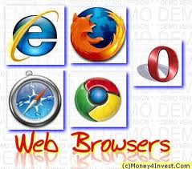
Web-based Applications
Most software applications today are written as web-based applications
Being run in an Internet browser

Slide 6

Web Testing Issues
Testing a web application is quite a bit more difficult than testing the same functionality in a Windows Desktop application
Various issues are present:
Timing difficulties
Differences between browsers
New technologies that make web browsing a rich, but difficult-to-test, experience

Slide 7

Web Testing Issues (2)
Web browsers don't provide clear visibility to what's happening on the page
The tester has no straight-forward way of consistently identifying an element on a web page and detecting changes in the element's state

Slide 8

Web Testing Issues (3)
New technologies introduce new testing issues
The same features that make web browsing a richer experience also present obstacles to testing
Asynchronous processes
Client side code running directly in the browser
Animation
Etc.

Slide 9

JavaScript
Before JavaScript the browser experience was completely server based
Entire pages were refreshed each time a button was clicked
With JavaScript you can have an action take place instantly without refreshing the page
This presents a whole new set of paths
They need to be checked to get full testing coverage

Slide 10

AJAX
AJAX = Asynchronous JavaScript And XML
JavaScript is capable of making calls to the server and updating selected portions of the page
From the testing perspective, AJAX may add a pause while information is retrieved from the server
AJAX is also "asynchronous"
Not all parts of the page are updated at one time

Slide 11


AJAX (2)
Handling AJAX
One of the principal ways AJAX can be handled is by waiting for a particular element to reach some state
E.g. "text content = '1234'"

Slide 12

Silverlight
Silverlight is a "plug in", object embedded to a standard web page
Runs right in the browser
Silverlight applications present unique testing issues
E.g. the Silverlight elements are not readily accessible
The user interface can be asynchronously updated
Elements are likely to be animated

Slide 13



Web Testing Tools Categories
Notes:
http://www.softwareqatest.com/qatweb1.html

Slide 14
Web Testing Tools
Web testing tools are a common type of test tool, used for:
Functional/Regression Testing
Load and Performance Testing
Web Site Security Testing
Web Site Management Testing
Mobile Web/App Testing
Notes:
http://www.softwareqatest.com/qatweb1.html

Slide 15
Web Testing Tools
Web testing tools are a common type of test tool, used for:
Scanning websites for broken or missing hyperlinks (Link checkers)
Static analysis on HTML, checking for conformance to standards

Slide 16




Main Web Testing Methods

Slide 17
Web Page Functionality Test
Functionality Testing
Check all the links
the outgoing links from all the pages from specific domain under test
all internal links
links jumping on the same pages
links used to send the email
check if there are any orphan pages
check for broken links

Slide 18
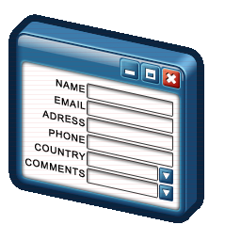
Web Page Functionality Test
Functionality Testing
Test forms in all pages
Check all the validations on each field
Check for the default values of fields
Wrong inputs to the fields in the forms
Options to create forms if any, form delete, view or modify the forms

Slide 19
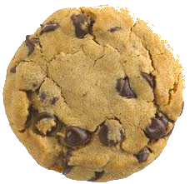
Web Page Functionality Test
Functionality Testing
Cookies testing
Test the application by enabling or disabling the cookies in your browser options
Test if the cookies are encrypted before they are written to user machine
Check application security by deleting the cookies

Slide 20

Web Page Functionality Test
Functionality Testing
Test HTML and CSS
Checking for syntax errors
Readable color schemas
Standard compliance
E.g. standards such W3C and ISO is followed

Slide 21

Web Page Functionality Test
Functionality Testing
Database testing
Testing the backend databases, like comparing the actual results with expected results

Slide 22

Web Page Functionality Test
Functionality Testing
Database testing basically include
Data validity testing
Test if any errors are shown while executing queries
Data Integrity testing
Maintained while creating, updating or deleting data in database
Check response time of queries
Test data retrieved from the database is shown accurately in the web application

Slide 23

Web Page Usability Test
Web page usability test
A method of simulating the user's way of experience
E.g., checking help links, contents in the page, checking menu options and their links, think times between the pages and message dialogs in the pages

Slide 24
Web Page Usability Test
Usability testing
Test for navigation
How the user surfs the web pages, different controls like buttons, boxes or how user using the links on the pages to surf different pages
Web site should be easy to use
Instructions should be provided clearly and correct (it means whether they satisfy purpose)

Slide 25
Web Page Usability Test
Usability testing
Content checking
Content should be logical, easy to understand and meaningful
Check for spelling errors
All the anchor text links should be working properly
Images should be placed properly with proper sizes

Slide 26

Web Page Usability Test
Usability testing
Interface Testing
The main layers are
Web server
Application server
Database server
Check if all the interactions between these servers are executed properly

Slide 27

Web Page Usability Test
Usability testing
Compatibility Testing
Browser compatibility
Operating system compatibility
Mobile browsing
Printing options

Slide 28
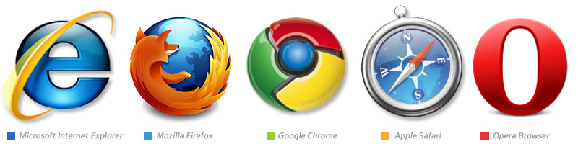
Web Page Compatibility
Testing web page compatibility
A method of testing multiple browsers based on user requirements
The web page presentation depends on how well the components are used

Slide 29
Web Page Compatibility Test
Sample browser compatibility checklist
CSS validation
HTML or XHTML validation
Page validations with and without JavaScript enabled
Ajax and jQuery functionality
Font size validation
Page layout in different resolutions
All images and alignment
Header and footer sections
Page styles
Date formats
Special characters with HTML character encoding
Page zoom-in and zoom-out functionality
You can repeat these tests on different browsers and operating systems

Slide 30

Security Testing
Security Testing basically include
Testing for vulnerabilities of the web application
Test unauthorized access to secure pages should not be permitted
Restricted files should not be downloadable without appropriate access
Check sessions are automatically killed after prolonged user inactivity

Slide 31

Performance Testing
Performance Testing
Verifies web page responses as per expectations based on the environment
Also includes stress testing and load testing of the application

Slide 32
Testing With Different Networks
Testing a web application using different networks
Required due to different points a user may access the system from
E.g., a local intranet or an internet with a lower network speed
An application's performance and the accessibility are based directly on the network used
This is also part of performance testing

Slide 33

Other Web Testing Methods
There are many other types of testing that can be performed as part of Web Performance Testing:
Using different operating systems
Using different databases
Installing different versions of an operating system

Slide 34

Test Environment
Set up a test environment that is separate from your development and production environment
This includes a separate web server, database server, and application server if applicable

Slide 35
Differences between Desktop, Client Server and Web Apps
Desktop App | Client Server App | Web App
Single tier app | 2 tier app | 3 tier app
App runs in single system | App runs in two or more systems | App runs in two or more systems
Single user | Limited number of users | Unlimited number of users
 | Connection exists until logout | Disconnected mode (stateless) – management of cookies
 | App in menu driven | App in URL driven
 | Known network issues in case of intranet as number of clients and servers are known | Many issues exist like hardware, browser and version compatibility, security issues, performance issues
 | Known users | Unknown users

Slide 36
Web Testing Tools
?
?
?
?
?
Questions?
?
?
?
?
?
?

Slide 37




Free Trainings @ Telerik Academy
C# Programming @ Telerik Academy
csharpfundamentals.telerik.com
Telerik Software Academy
academy.telerik.com
Telerik Academy @ Facebook
facebook.com/TelerikAcademy
Telerik Software Academy Forums
forums.academy.telerik.com

